Slide 1
Camp track App Leader User Guide
App URL:
https://camp-qr-checkin.web.app/
Disclaimer: All personal and church names shown in this guide are fictitious and used solely for illustration purposes.

Slide 2
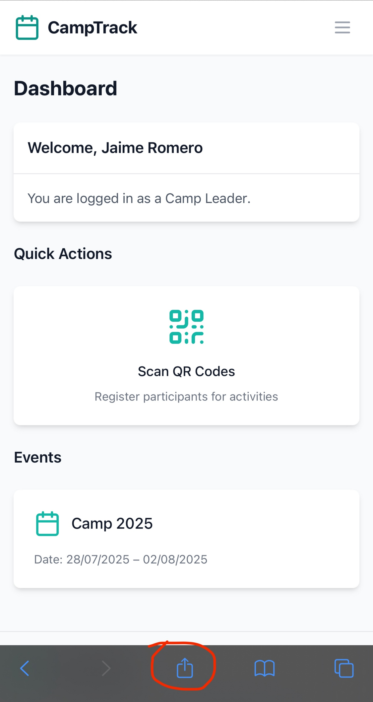
Dashboard and App icon
First, we recommend adding the app to your home screen for quick access. Tap the page options menu to begin.

Slide 3
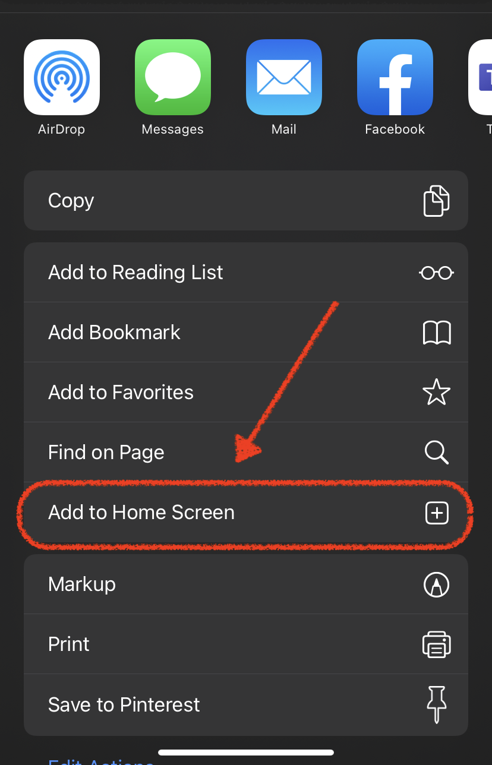
Dashboard and App icon
Then simply select “Add to Home Screen.” This step should look similar on both iPhone and Android.
If prompted, enter a simple name for your icon (e.g., “CampTrack”).

Slide 4
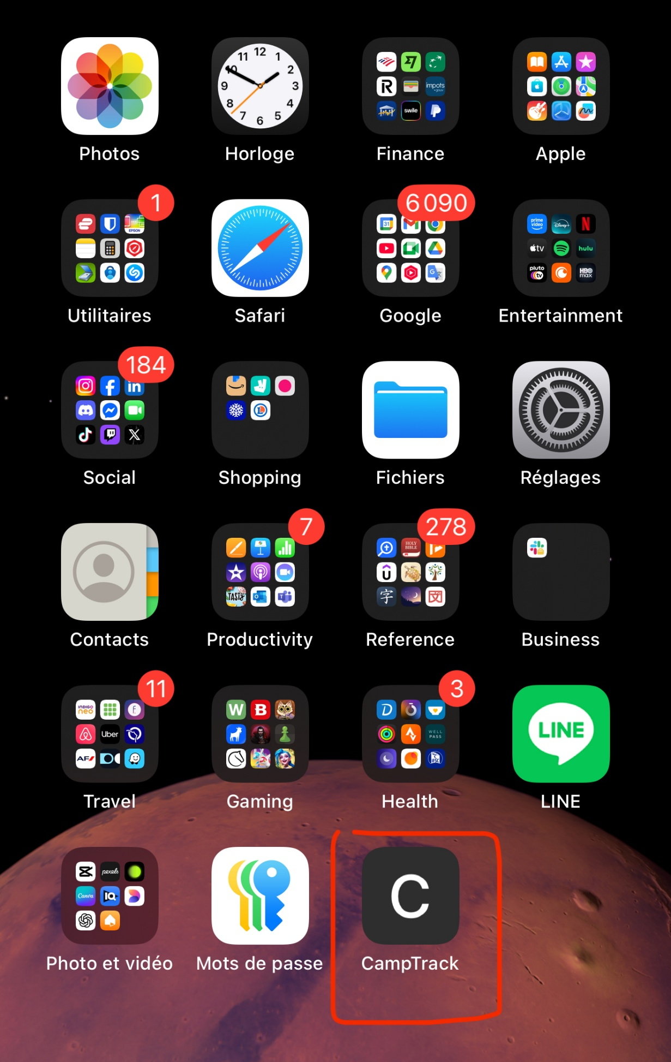
Dashboard and App icon
You should now see the web app icon on your Home Screen, making it easy to access anytime.

Slide 5
Scanning a QR code
To scan a participant’s QR code, tap the Scan quick action from the dashboard or open it from the app menu.

Slide 6
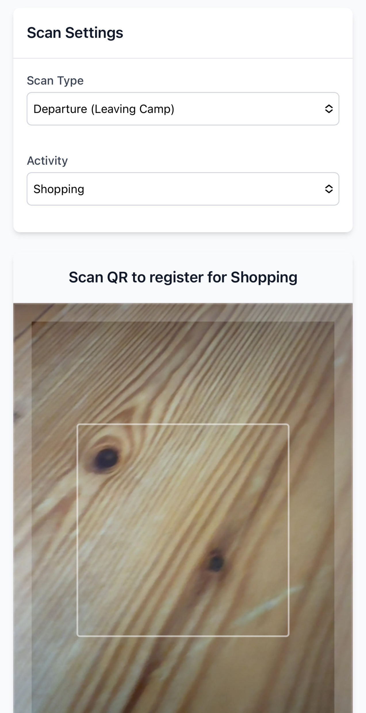
Scanning a QR code
On the Scanner page, select the scan type (departure or return).
If scanning a departure, choose the activity the participant is leaving for.

Slide 7
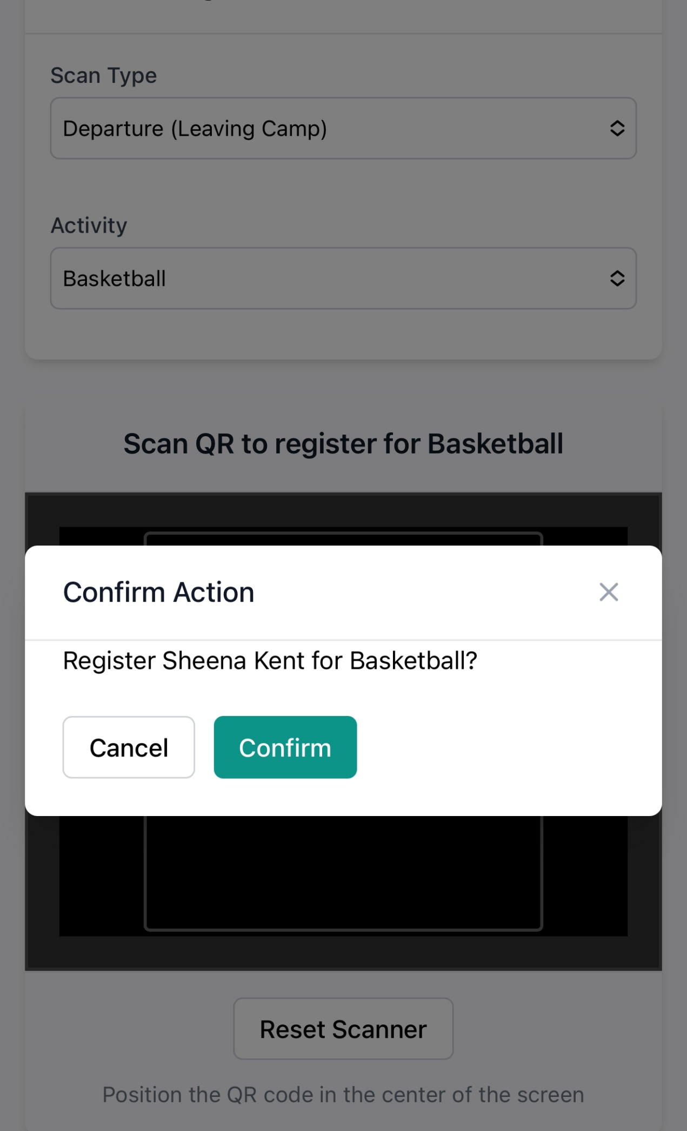
Scanning a QR code
You’ll need to confirm that everything looks correct to complete the scan.
Also, note the Reset Scanner button, which you can use if scanning doesn’t work.

Slide 8
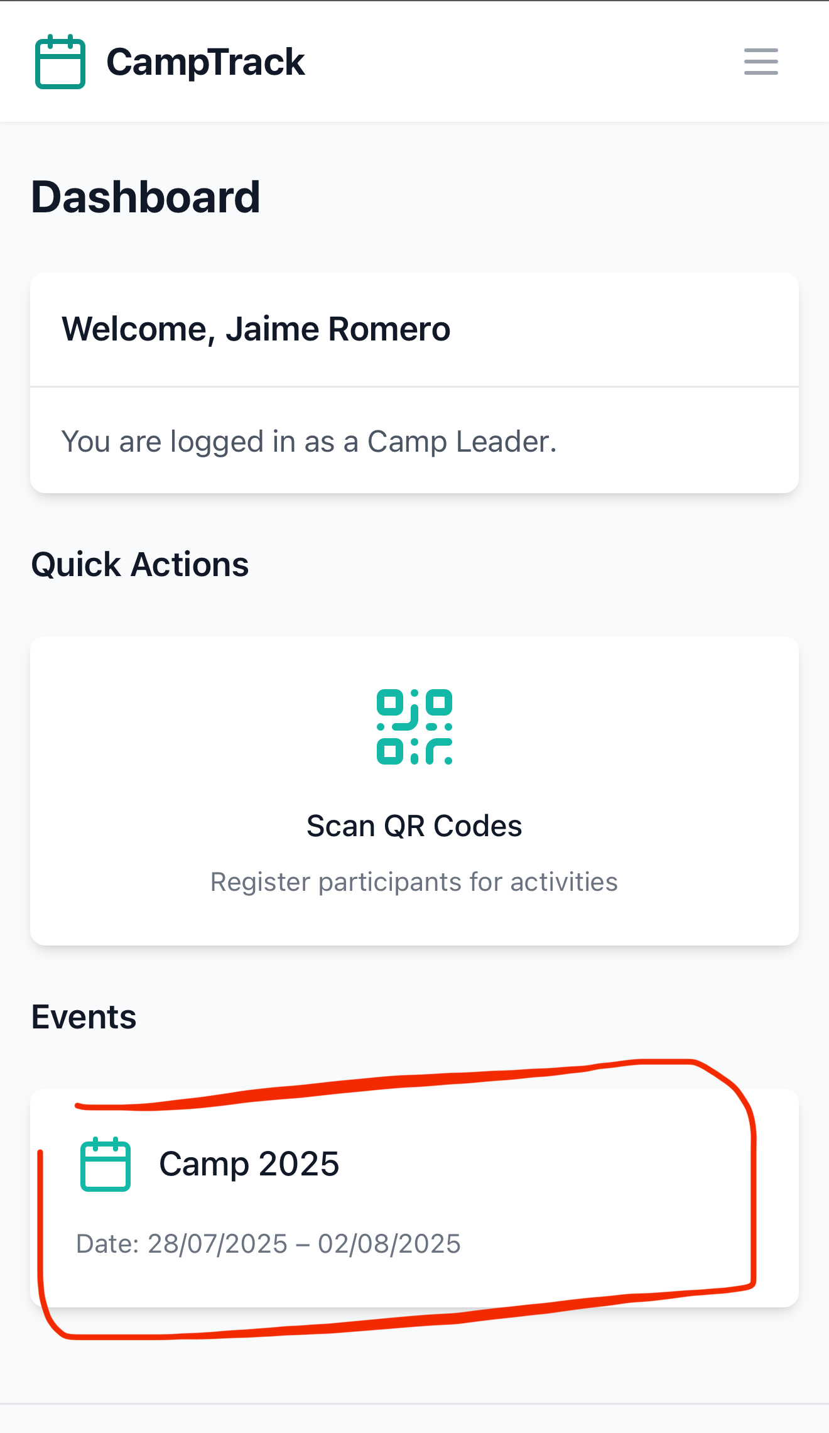
Participant location
From the Dashboard, you can access the Event Detail page to view participant locations and scan history.

Slide 9
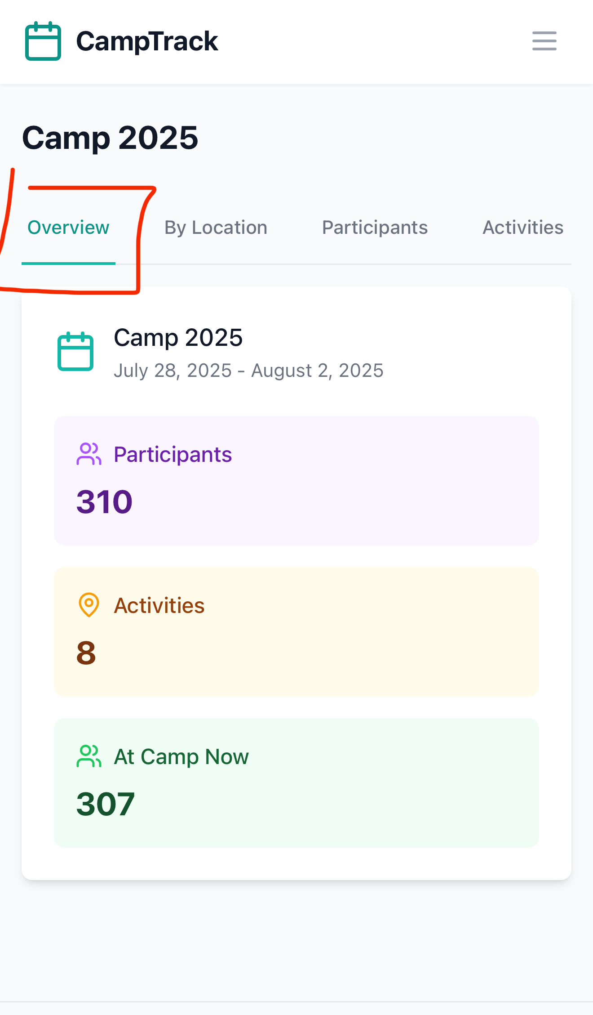
Participant location
In the Overview tab, you can see the total number of participants, the number of activities, and how many are currently At Camp.

Slide 10
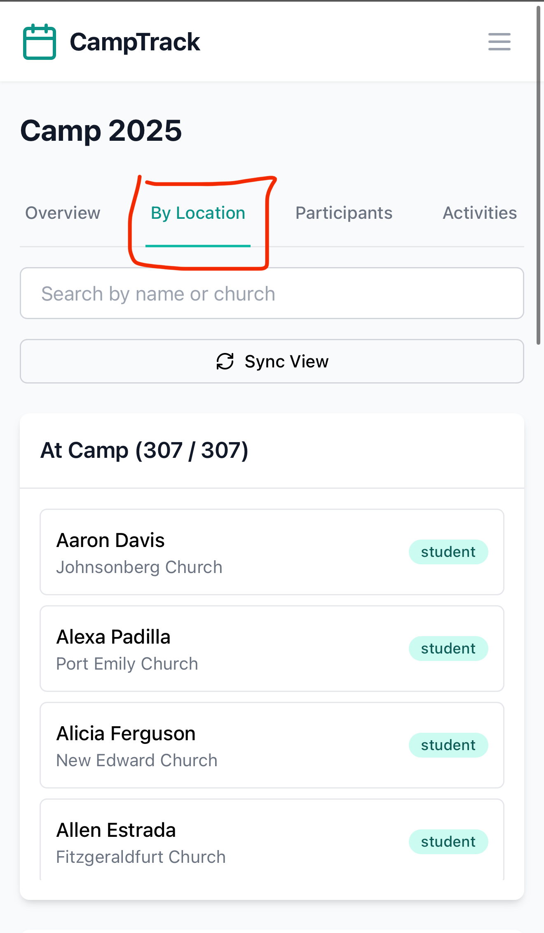
Participant location
In the By Location tab, you can see participants grouped by location.
You can also use the search bar to filter by participant name or church.

Slide 11
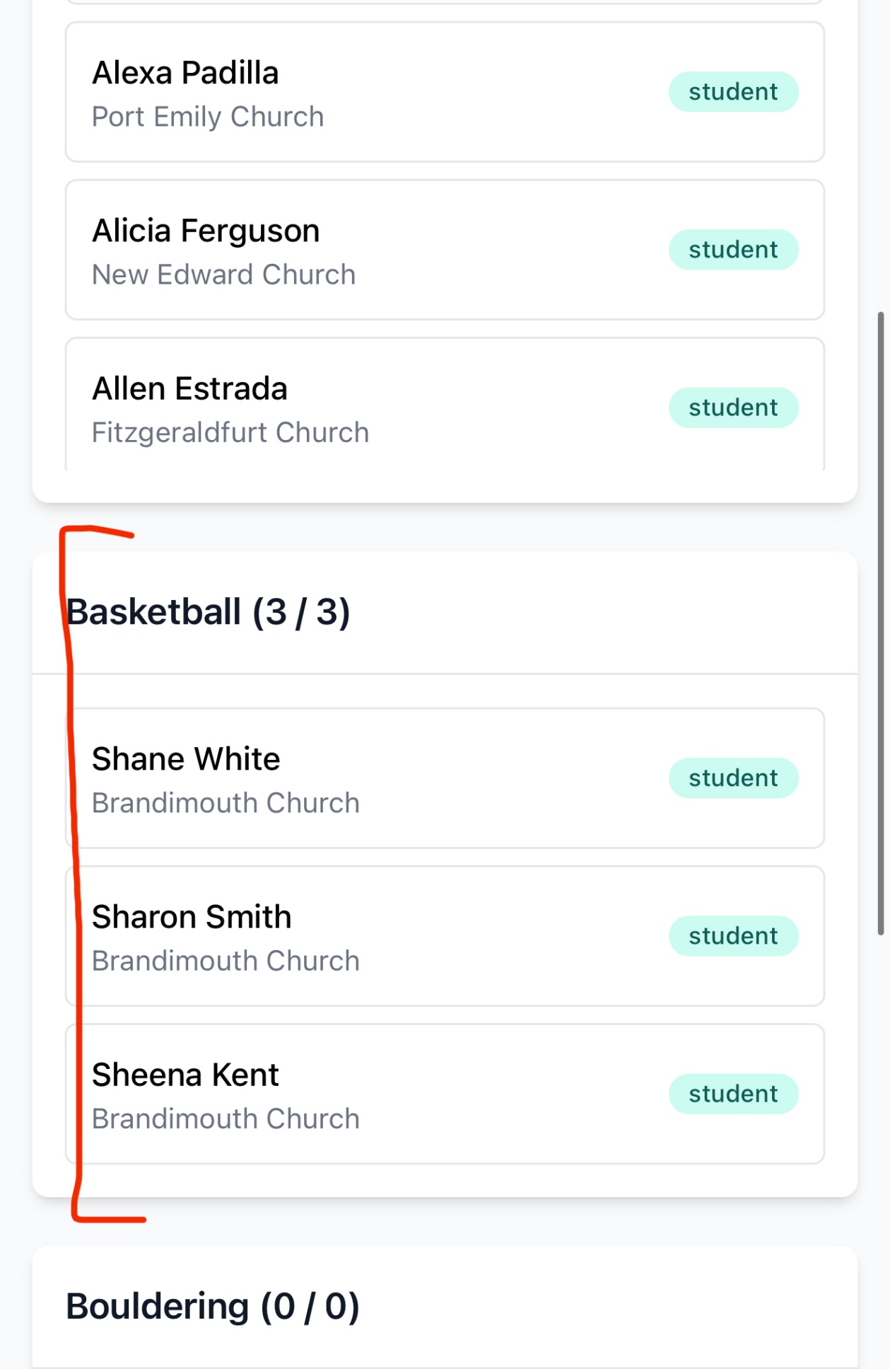
Participant location
As you scroll down, you’ll see participants currently in each scanned location.

Slide 12
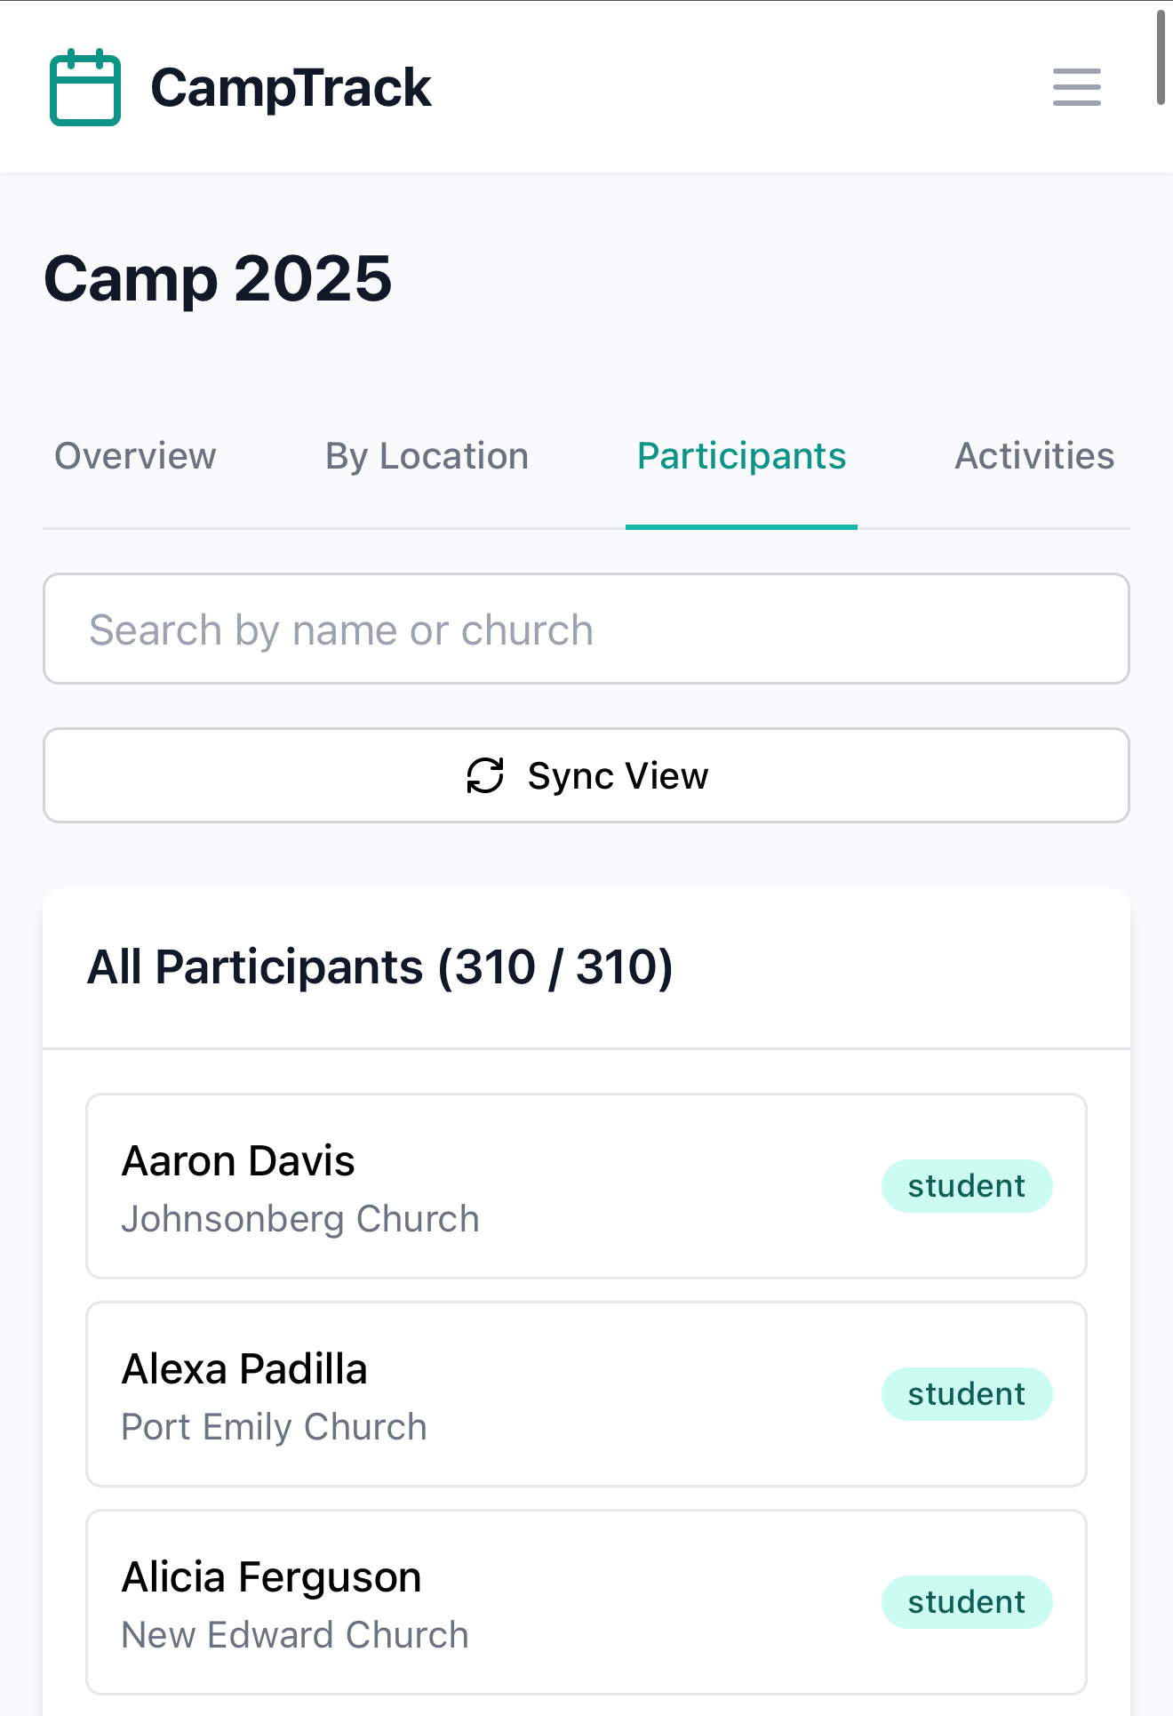
Participant location
In the Participants tab, you’ll find the full list of participants enrolled in the camp.

Slide 13
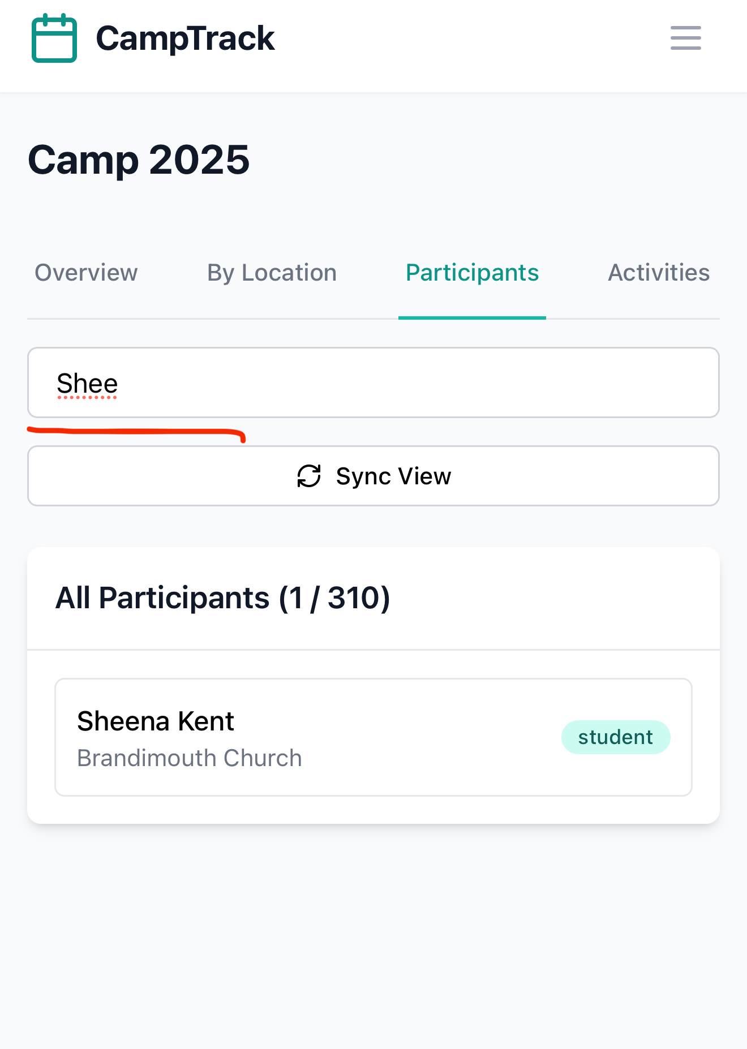
Participant location
In this view, you can also use the search bar to filter results.
Tap any student to view their scan history.

Slide 14
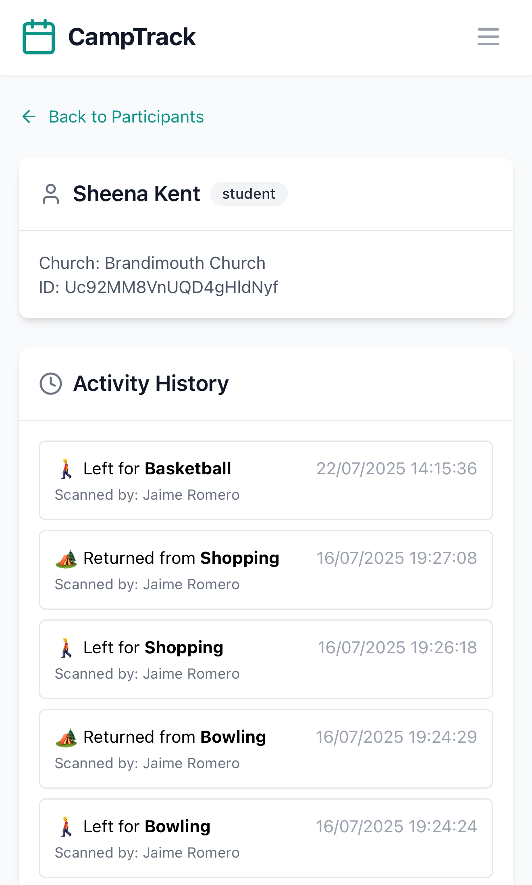
Participant location
In the participant’s scan history, you’ll see who scanned them, the time, and the related activity details.

Slide 15
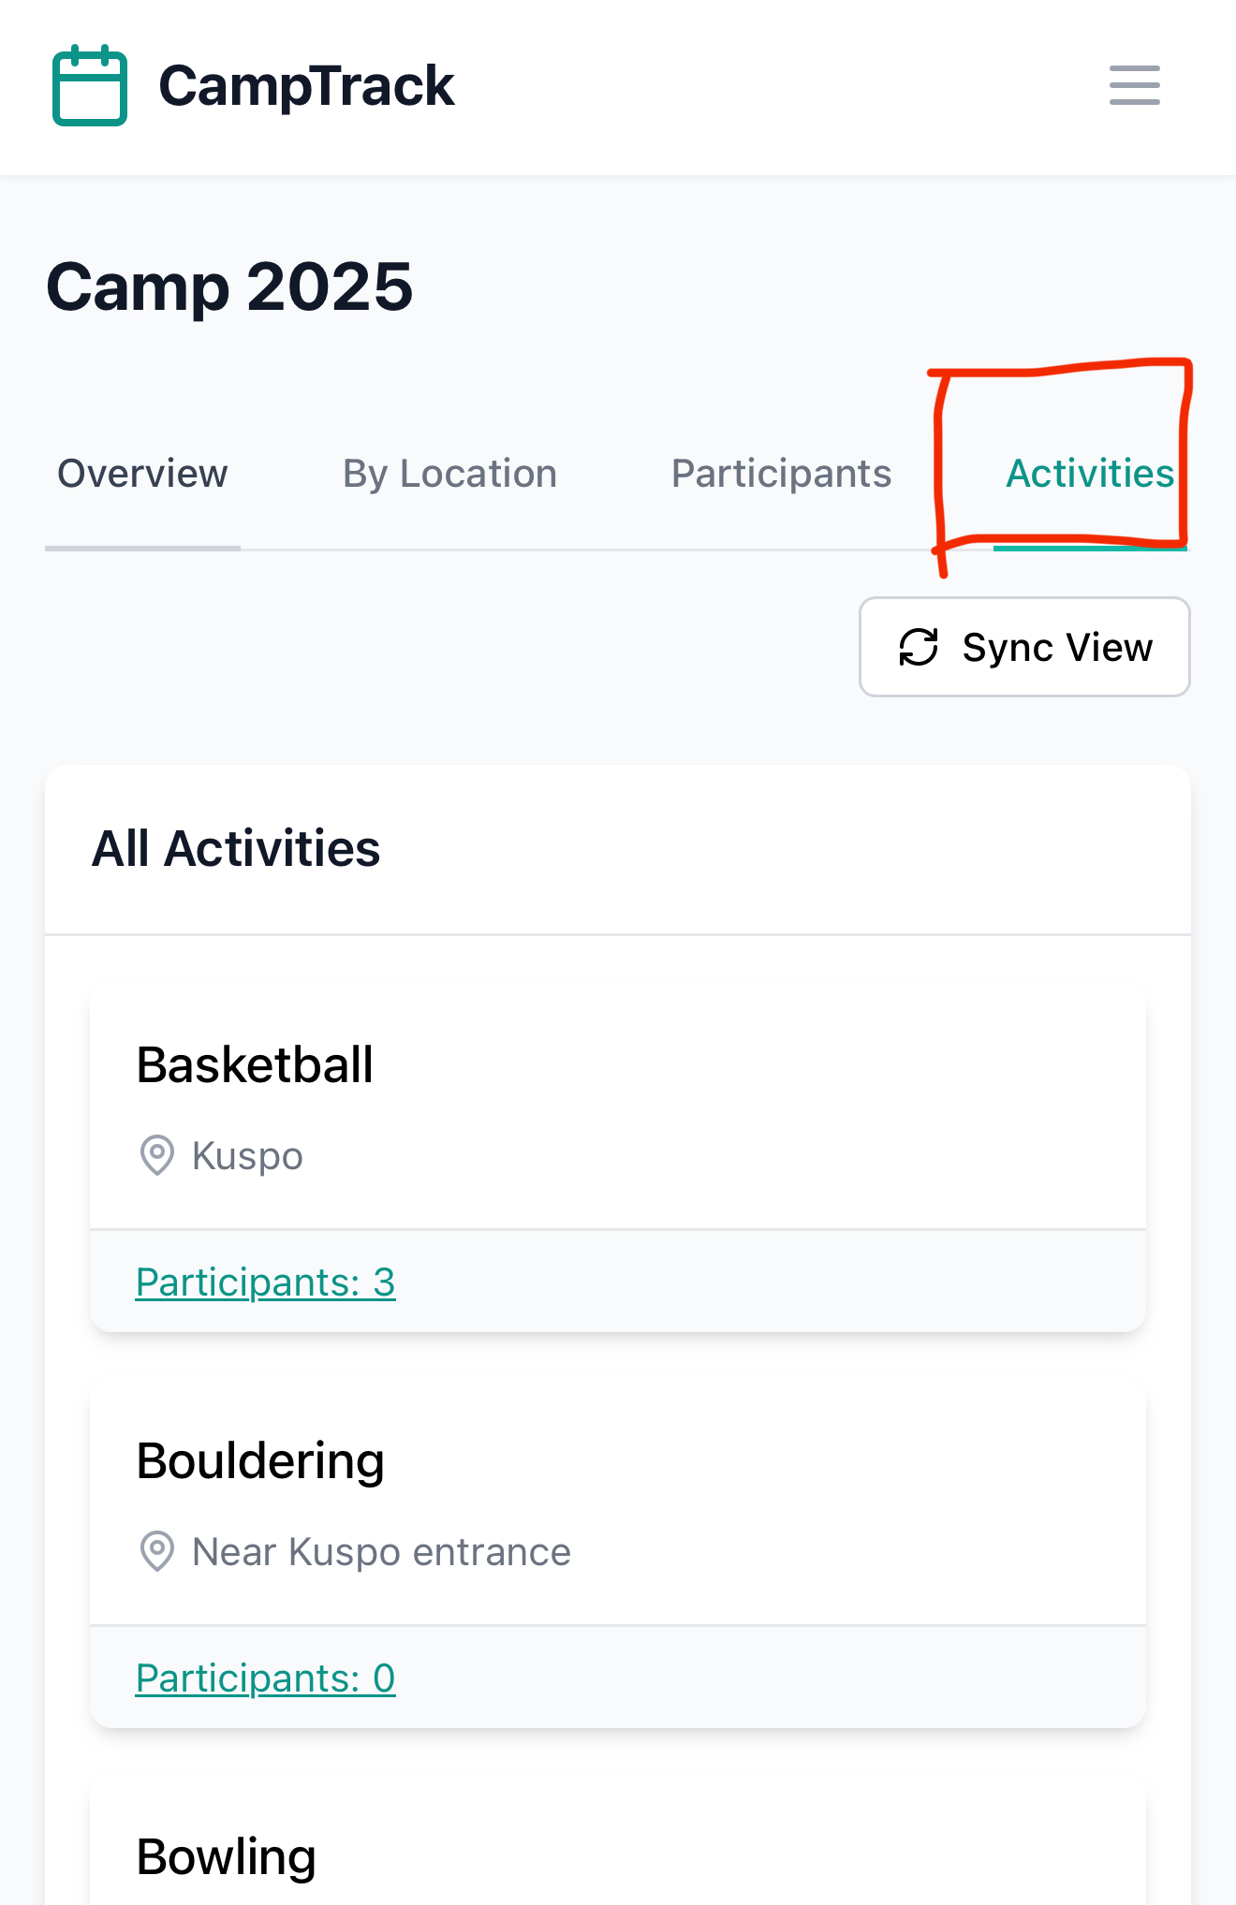
Activity
In the Activities tab, you can view all available activities along with their number of active participants.
You can also tap any activity to see its participant list.

Slide 16
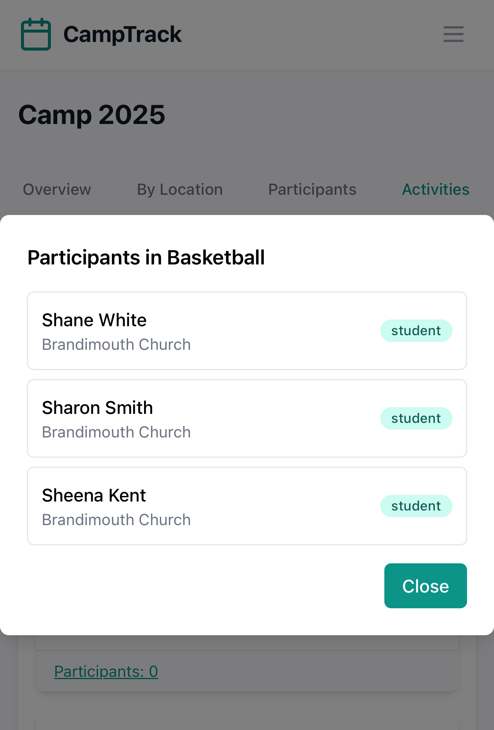
Activity
This concludes the overview of all app features available to Camp Leader users.

